Slide 1
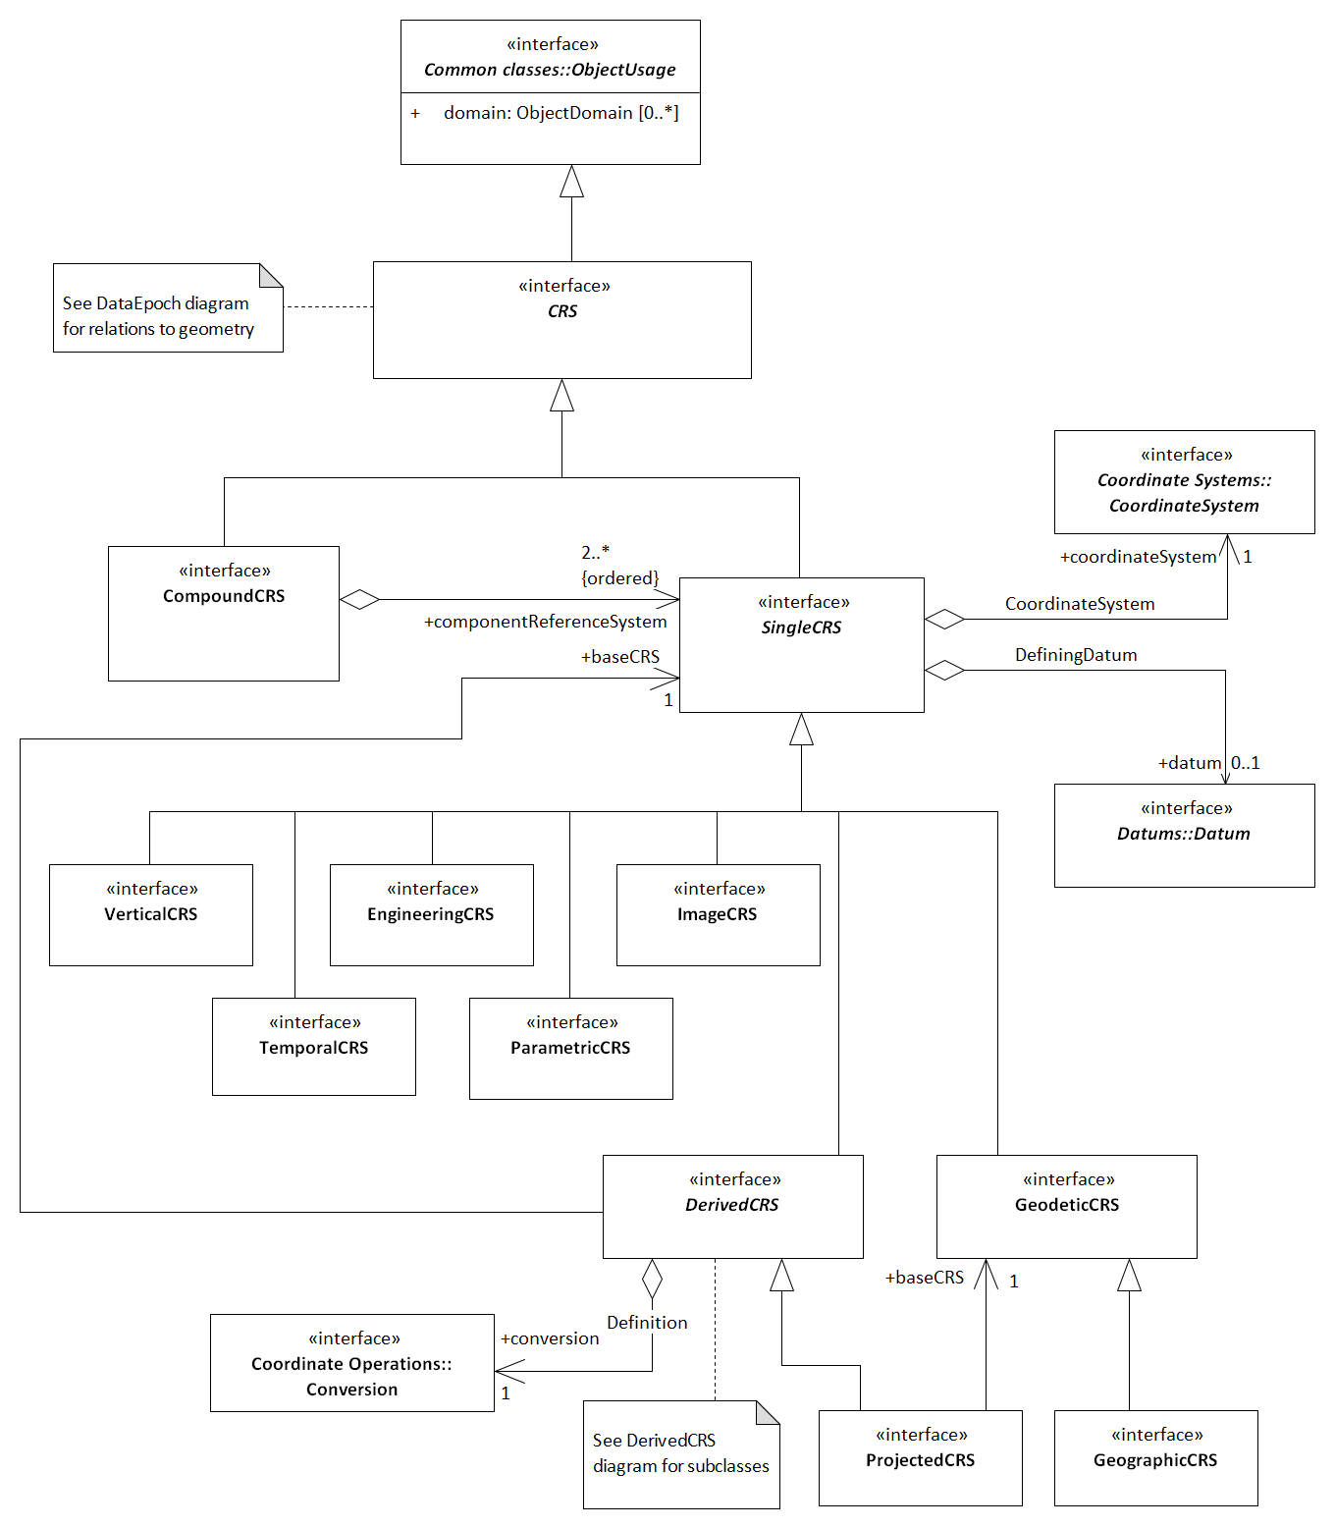
Geoid-based vertical CRS
HeightCorrection
+transformation 0..*
<<interface>>
Coordinate Operations::
Height Correction model
<<interface>>
Coordinate Operations::
Transformation

Slide 2
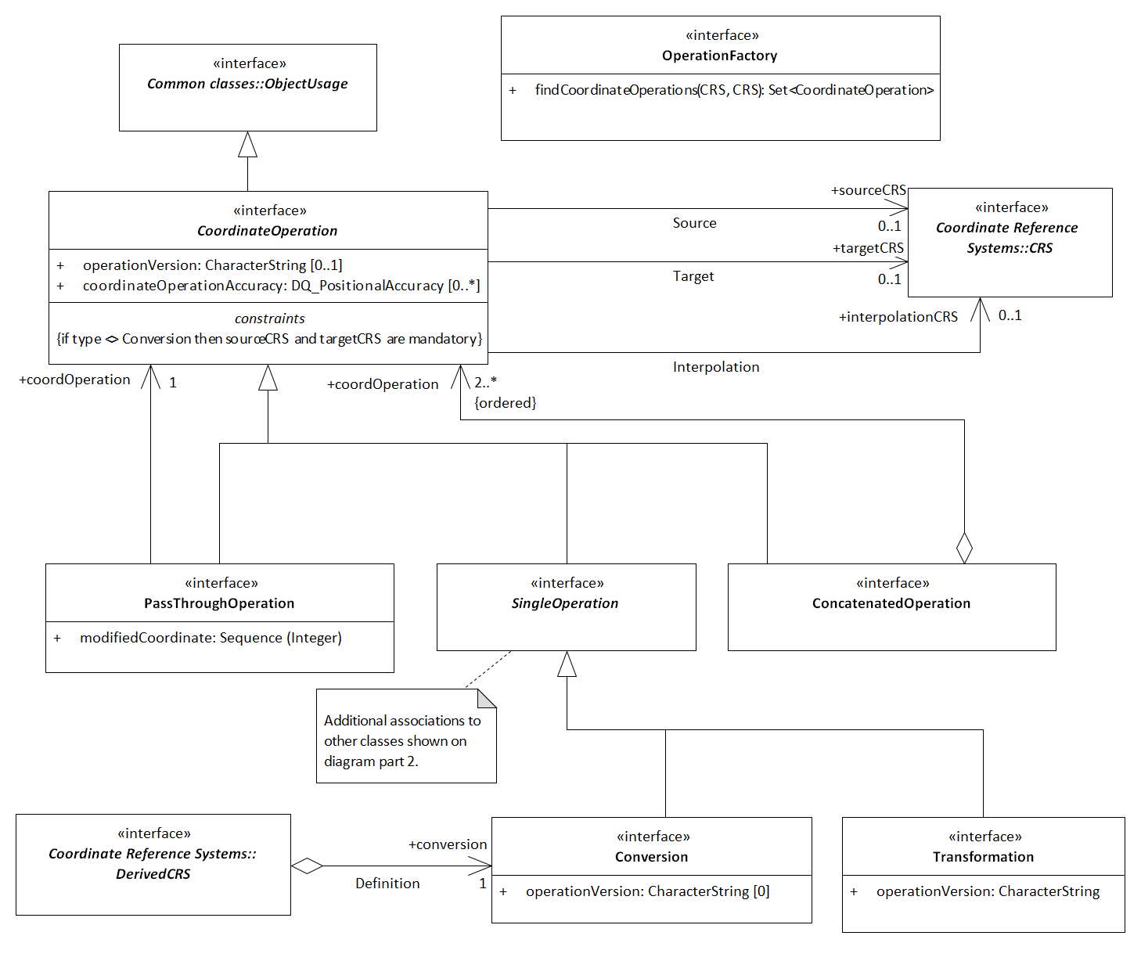
Geoid-based vertical CRS
+transformation 0..*
HeightCorrection
<<interface>>
Coordinate Reference Systems::
VerticalCRS

